Slide 1
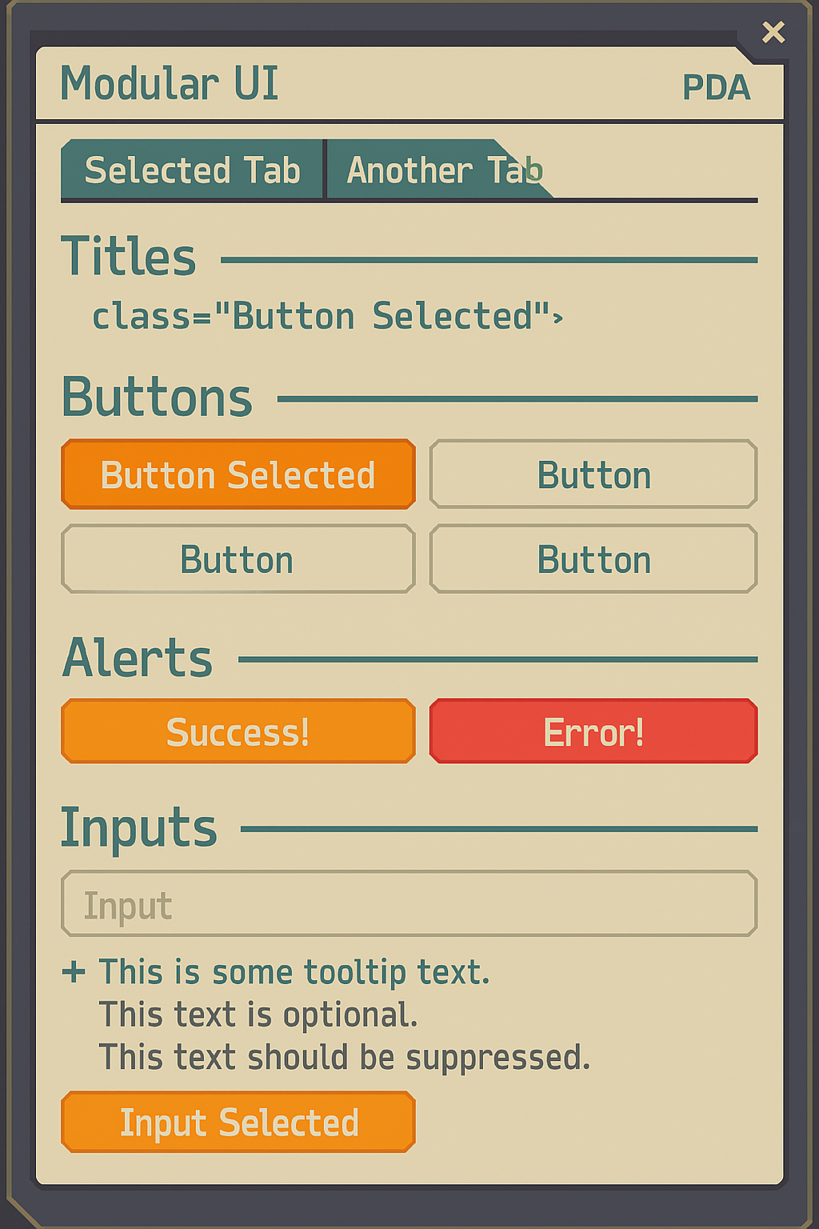
PDA Palette
screen
f8f2de
text
5ba9a9
highlight
f1693c
lines
30393e
alternate highlight
f99e2a
error/alert
d94f4f
disabled/inactive
b8b8b8
success/confirmation
4caf50
selected
e6d8b8
tooltip
ffffff (with 85% opacity)
shadow
1e1e1e (with 85% opacity)
glow/focus
f1693c (60% opacity)

Slide 2
Save as JPG, not PNG

Slide 3
RECEPTION
SECURITY OFFICE
MEDICAL OFFICE
STORAGE ROOM

Slide 4
TV ROOM
DINING ROOM
GYMNASIUM

Slide 5
SHOWER BLOCK
TOILET BLOCK
NO CAMERA FEED

Slide 6
CELL #1
CELL #5
CELL #2
CELL #3
CELL #6
CELL #4

Slide 7
RECEPTION CORRIDOR
OFFICE CORRIDOR
BACK CORRIDOR
RECREATION CORRIDOR

Slide 8
STAIRS (DOWN)
STAIRS (UP)
CELLS LANDING

Slide 9
Induction
Process
Record identification
Medical check
Remove personal property
Cell assignment

Slide 10
World Orbital Prison: MEDICAL SCANNER
File Home Scan Help
Prisoner ID:
H4095696
Scan Type:
Prisoner Induction
Annual Checkup
Prohibited Substances
Cancel
Prisoner Release
SCAN

Slide 11
















THIS WAY UP

Slide 12
Prisoner
Property
Log
DO NOT REMOVE
Prisoner Property Log
A to G
Prisoner Property Log
H to M
Prisoner Property Log
N to S
Prisoner Property Log
T to Z

Slide 13
Action Hint Background

